Slide 1


BY KISHORE S

Slide 2

🞂​ MySQL is a Database Software.
🞂​ MySQL is a relational database management system.
🞂​ MySQL is open-source.
🞂​ MySQL is free to download.
🞂​ MySQL is ideal for both small and large applications.
🞂​ MySQL is very fast, reliable, scalable, and easy to use.
🞂​ MySQL is secured for storing data in database.

Slide 3


MySQL.
🞂​ MYSQL Workbench is the Official Graphical User Interface(GUI) Tool for
🞂​ It allows you to design, create and browse your database schemas, work with database objects and insert data as well as design and run SQL queries to work with stored data.
🞂​ You can also migrate schemas and data from other database vendors to your MySQL database.
MySQL WORKBENCH 8.0 Community Versions of MySQL 8.0.34

Slide 4


MySQL Server Workbench.
Oracle.
Microsoft Server.
MangoDB.
Navigation.
No SQL.

Slide 5
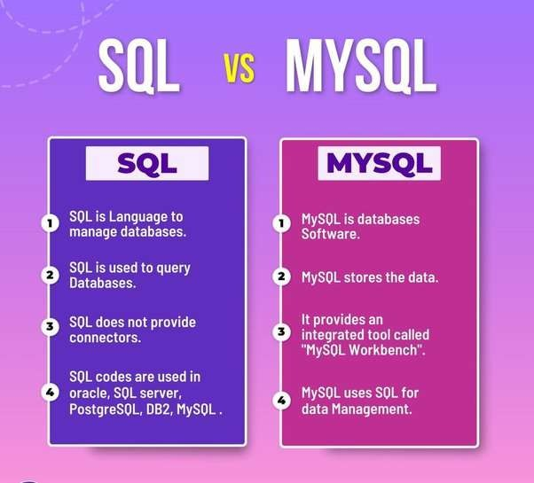



Slide 6
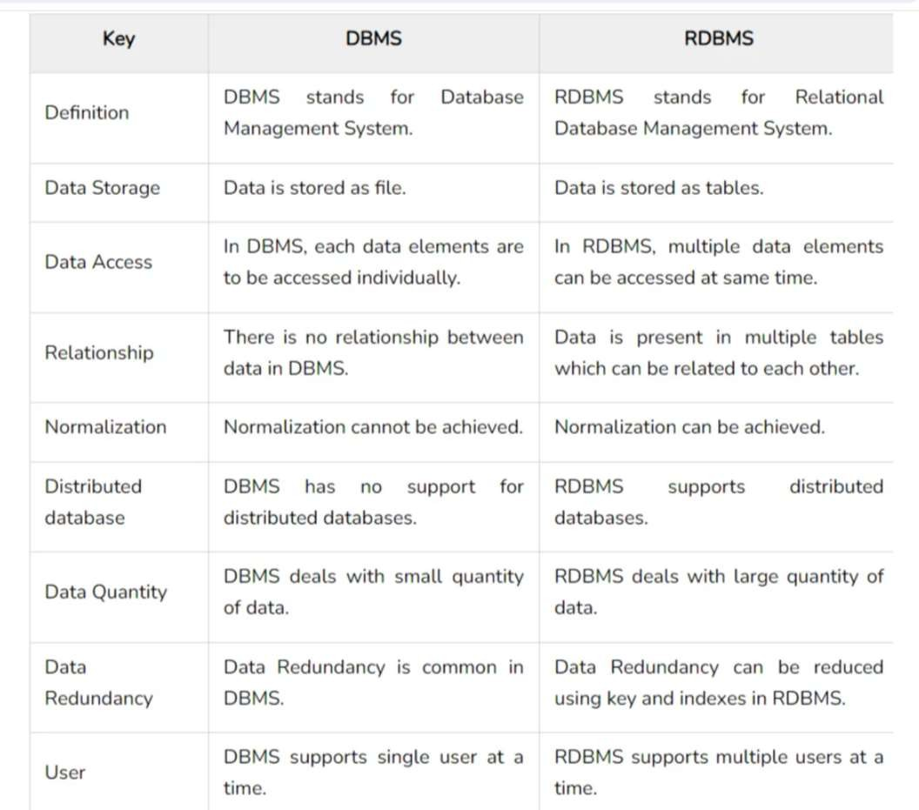

Slide 7

Numeric Datatype.
String Datatype.
DateTime Datatype.
Large Object-(For file and Picture Saving).

Slide 8

🞂​ Super Key
🞂​ Candidate Key
🞂​ Primary Key
🞂​ Alternate Key or Secondary Key
🞂​ Foreign Key
PRIMARY KEY :
🞂​ A table/ Relation can have only one primary key allowed.
🞂​ No NULL Values.
🞂​ No Duplicate Values.
🞂​ Ex:emp_id.

Slide 9
🞂​ Set of one or more attributes that allows identifying an entity uniquely.
🞂​ (For Ex) (Student_Id, Student_Name, Roll_no, Email_id).
CANDIDATE KEY
🞂​ Candidate keys are a subset of super keys.
🞂​ Multiple candidate keys are allowed.
🞂​ No repeated Attributes .
🞂​ For Ex (Student_ID, Roll_no).

Slide 10
addition to the primary key to locate specific data.
🞂​ A secondary key is an additional key, or alternate key, which can be use in
🞂​ (Primary Key - Candidate key)
FOREIGN KEY
🞂​ A foreign key is a reference key.
🞂​ Foreign key is a key used to link two tables together.
🞂​ Foreign key is used to maintain relationship between two tables.
🞂​ Ex. Foreign key(dept_no).

Slide 11

🞂​ MySQL General Commands
🞂​ MySQL General Functions
🞂​ MySQL String Functions
🞂​ MySQL Date Functions
🞂​ MySQL Calculate Functions
🞂​ MySQL Logical Functions
🞂​ MySQL Joins
🞂​ MySQL Stored Procedure
🞂​ MySQL Triggers

Slide 12
🞂​ SELECT - extracts data from a database
🞂​ UPDATE - updates data in a database
🞂​ DELETE - deletes data from a database
🞂​ INSERT INTO - inserts new data into a database
🞂​ CREATE DATABASE - creates a new database
🞂​ ALTER DATABASE - modifies a database
🞂​ CREATE TABLE - creates a new table
🞂​ ALTER TABLE - modifies a table
🞂​ DROP TABLE - deletes a table

Slide 13
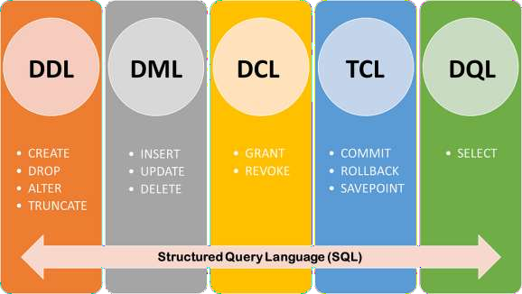
🞂​ DDL- DATA DEFINITION LANGUAGE
🞂​ DML-DATA MANIPULATION LANGUAGE
🞂​ DQL- DATA QUERY LANGUAGE
🞂​ TCL-TRANSACTION CONTROL LANGUAGE
🞂​ DCL-DATA CONTROL LANGUAGE

Slide 14


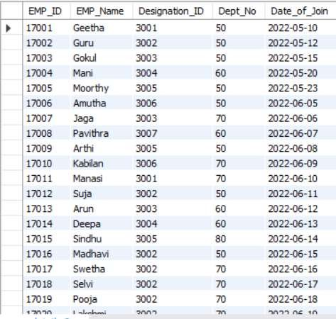
🞂​ create table EMP_details(EMP_ID int primary key,EMP_Name varchar(25),Designation_ID int,Dept_No int,Date_of_Join date);
🞂​ Insert into emp_details values;
🞂​ OUTPUT:

Slide 15


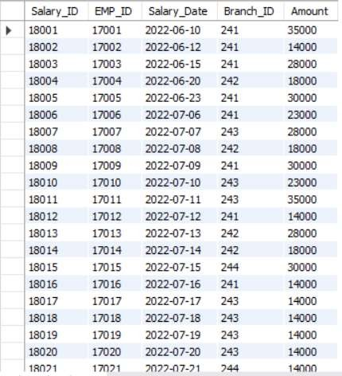
🞂​ create table Salary_Details(Salary_ID int primary key, EMP_ID int,Salary_Date date,Branch_ID int,Amount int);
🞂​ insert into Salary_Details values;
🞂​ OUTPUT:

Slide 16


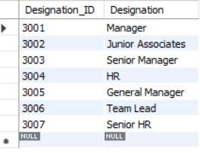
🞂​ create table Designation_Det(Designation_ID int primary key, Designation varchar(50));
🞂​ insert into Designation_Det values;
🞂​ OUTPUT:

Slide 17


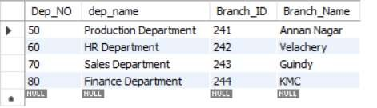
🞂​ create table Department_Det(Dep_NO int,Dep_NAME varchar(30),Branch_ID int primary key,Branch_Name varchar(30));
🞂​ Insert into Department_Det values;
🞂​ OUTPUT:

Slide 18
🞂 | Where | 🞂 | Count
🞂 | or | 🞂 | Distinct
🞂 | and | 🞂 | Count With Distinct
🞂 | in | 🞂 | Order by Asc
🞂 | Not in | 🞂 | Order By Desc
🞂 | > | 🞂 | Group By
🞂 | < | 🞂 | Limit
🞂 | >= | 🞂 | Desc Limit
🞂 | <= | 🞂 | Like (_%)
🞂 | <> (Not in) | 🞂 | Not like
🞂 | ! | 🞂 | Between

Slide 19


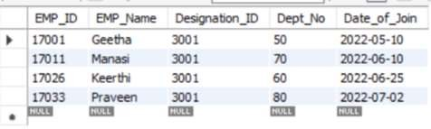
🞂​ The WHERE clause is used to filter records.
🞂​ It is used to extract only those records that fulfill a specified condition.
QUERY: select * from emp_details where designation_id=3001;

Slide 20


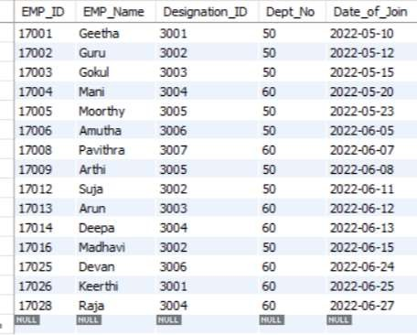
🞂​ The OR operator displays a record if any of the conditions separated by OR is TRUE.
QUERY: select * from emp_details where dept_no=50 or dept_no=60;
OUTPUT:

Slide 21


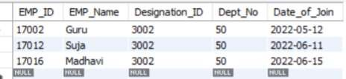
🞂​ The AND operator displays a record if all the conditions separated by AND are TRUE.
QUERY : select * from emp_details where dept_no=50 and designation_id=3002;
OUTPUT:

Slide 22


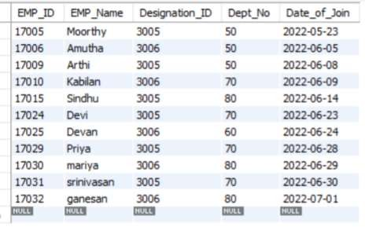
🞂​ The IN operator allows you to specify multiple values in a WHERE clause.
QUERY : select * from emp_details where designation_id in (3005,3006);
OUTPUT:

Slide 23


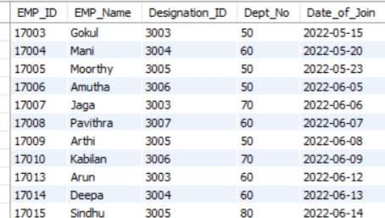
🞂​ The NOT IN operator does not allows you to specify multiple values in a WHERE clause.
QUERY : select * from emp_details where designation_id not in (3001,3002);
OUTPUT:

Slide 24

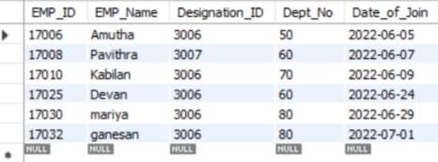
🞂​ The greater than operator is used to show the higher values.
QUERY : select * from emp_details where designation_id > 3005;
OUTPUT:
.

Slide 25

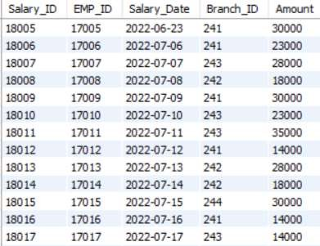
🞂​ The greater than or equal to is used to show the higher values and also the
equal to values.
QUERY : select * from salary_details where salary_id >=18005;
OUTPUT:

Slide 26


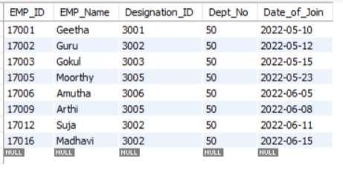
🞂​ The lesser than operator is used to show the lower values.
QUERY : select * from emp_details where dept_no < 60;
OUTPUT:

Slide 27



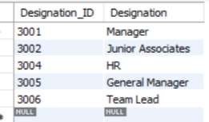
The LIKE operator is used in a WHERE clause to search for a specified pattern in a column.
🞂​ The percent sign % represents zero, one, or multiple character.
🞂​ The underscore sign _ represents one, single character.
QUERY : select * from emp_details where emp_name like '_a%';
select * from emp_details where emp_name like 'd%';
NOT LIKE
select * from designation_det where designation not like 's%';

Slide 28



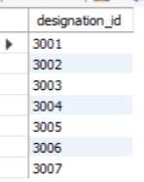
🞂​ The COUNT() function returns the number of rows that matches a specified
criterion..
QUERY : select count(emp_id) as Total_employees from salary_details;
DISTINCT:
🞂​ The SELECT DISTINCT statement is used to return only distinct (different)
values.
QUERY : select distinct designation_id from emp_details;

Slide 29



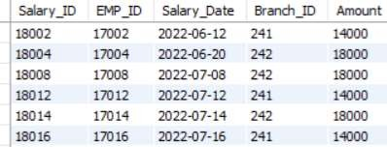
🞂​ This is used to find the count values of distinct values.
Query: select count(distinct dept_no)count_dept from emp_details;
BETWEEN AND
🞂​ The BETWEEN operator selects values within a given range. The values can be
numbers, text, or dates.
QUERY : select * from salary_details where amount between 10000 and 20000;

Slide 30

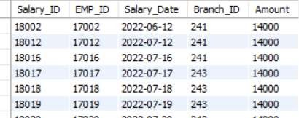

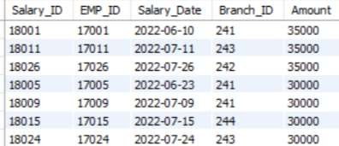
🞂​ select * from salary_details where amount between 10000 and 20000;
QUERY: select * from salary_details order by amount asc;
ORDER BY DESCENDING
QUERY : select * from salary_details order by amount desc;

Slide 31



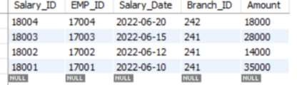
🞂​ The limit is used to filter the specified range of values.
QUERY : select * from emp_details limit 23,2;
LIMIT DESC
QUERY : select * from salary_details order by salary_id desc limit 29,4;

Slide 32


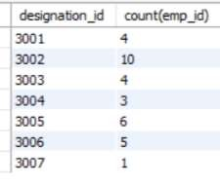
🞂​ The GROUP BY statement groups rows that have the same values into summary rows, like "find the number of customers in each country".
🞂​ The GROUP BY statement is often used with aggregate functions (COUNT(), MAX(), MIN(), SUM(), AVG()) to group the result-set by one or more columns.
QUERY :
select designation_id,count(emp_id) from emp_details group by
designation_id;

Slide 33
🞂​ LCase
🞂​ UCase
🞂​ Left
🞂​ Right
🞂​ Concat
🞂​ Trim
🞂​ Char_Length
🞂​ Mid
🞂​ Length

Slide 34

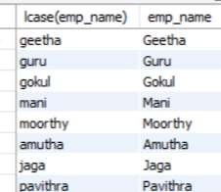

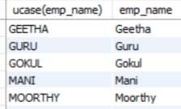
Query : select lcase(emp_name), emp_name from emp_details;
OUTPUT
Upper Case
Query : select ucase(emp_name),emp_name from emp_details;
OUTPUT

Slide 35





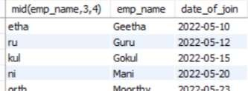
Query : select left(emp_id,2),emp_name,date_of_join from emp_details;
OUTPUT :
RIGHT
Query : select right(emp_id,3),emp_name,date_of_join from emp_details;
OUTPUT :
MID
Query : select mid(emp_name,3,4) ,emp_name,date_of_join from emp_details;
OUTPUT :

Slide 36





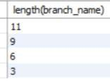
🞂​ The CONCAT function adds two or more strings together.
QUERY: select concat(emp_id,".",ucase(emp_name))Employee_det, designation_id
from emp_details;
TRIM
🞂​ The TRIM function removes leading and trailing spaces from a string.
QUERY : select trim(designation) as jobs from designation_det;
LENGTH
🞂​ The LENGTH() function returns the number of bytes used to represent an expression
QUERY : select length(branch_name) from department_det;

Slide 37




🞂​ Sum
🞂​ Average
🞂​ Min
🞂​ Max
🞂​ Count
SUM
🞂​ The SUM() function returns the total sum of a numeric column.
QUERY: select sum(amount) as total_sal_amount from salary_details;
AVERAGE
🞂​ The AVG function returns the average value of a numeric column.
QUERY : select round(avg(amount),0) as avg from salary_details;

Slide 38






🞂​ The MAX function returns the largest value of the selected column.
QUERY : select max(amount) as max_sal from salary_details;
MIN
🞂​ The MIN function returns the smallest value of the selected column.
QUERY : select min(amount) as min_sal from salary_details;
COUNT
🞂​ The COUNT function returns the number of rows that matches a specified criterion.
QUERY : select count(salary_id) from salary_details;

Slide 39




DATE ADD:
QUERY :select *,date_add(date_of_join,interval 1 month)as Salary_date from emp_details;
DATE DIFF :
QUERY: select *,round(datediff(curdate(),date_of_join)/365,1) as emp_experience_yrs from emp_details;

Slide 40

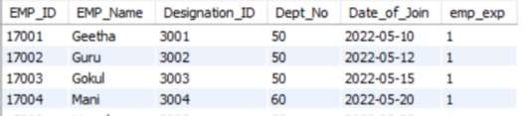

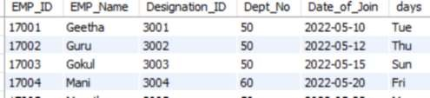
emp_details;
QUERY : select *,timestampdiff(year,date_of_join,curdate()) as emp_exp from
DATE FORMAT
QUERY : select *, date_format(date_of_join,'%a')as days from emp_details;

Slide 41






YEAR :
QUERY : select * from salary_details where year(salary_date)='2022';
MONTH :
QUERY : select * from salary_details where month(salary_date)='06';
DAY :
QUERY : select * from salary_details where day(salary_date)='12';

Slide 42

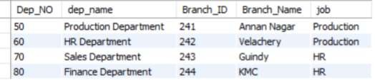
🞂​ IF
🞂​ COUNT IF
🞂​ IF WITH AND CONDITIONS
🞂​ IF WITH OR CONDITIONS
IF CONDITIONS :
QUERY : select *, if(dep_no<=60,'Production','HR') as job from department_det;
OUTPUT :

Slide 43


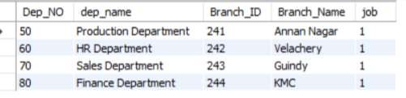
QUERY : select *, count(if(dep_no<=60,'Production','HR') ) as job from
department_det group by branch_id;
OUTPUT :

Slide 44

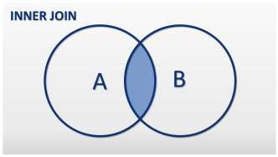
🞂​ A JOIN clause is used to combine rows from two or more tables, based on a related
column between them.
🞂​ Types of Joins are:
INNER JOIN LEFT JOIN RIGHT JOIN CROSS JOIN
INNER JOIN :
🞂​ The INNER JOIN keyword selects records that have matching values in both
tables.

Slide 45

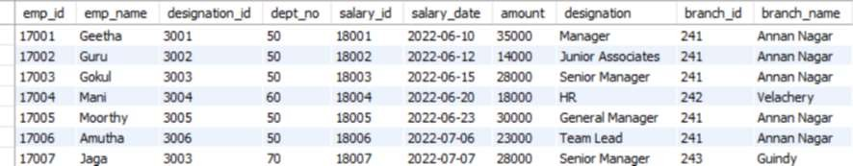
QUERY : select emp_details.emp_id,emp_details.emp_name,emp_details.designation_id,emp_detai ls.dept_no,salary_details.salary_id,salary_details.salary_date,salary_details.amount
,designation_det.designation,department_det.branch_id,department_det.branch_na me from emp_details inner join salary_details on emp_details.emp_id=salary_details.emp_id inner join designation_det ondesignation_det.designation_id=emp_details.designation_id inner join department_det on department_det.dep_no=emp_details.dept_no;
OUTPUT :

Slide 46
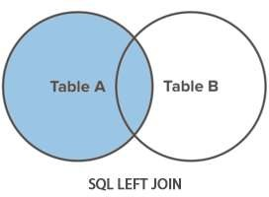

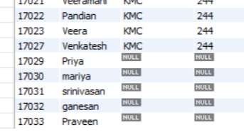
🞂​ The LEFT JOIN keyword returns all records from the left table (table1), and the
matching records (if any) from the right table (table2).
QUERY :
select
emp_detailsjj.emp_id,emp_detailsjj.emp_name,department_det.branch_name,department_det
.branch_idfrom emp_detailsjj left join department_det on emp_detailsjj.dep_no=department_det.dep_no;

Slide 47
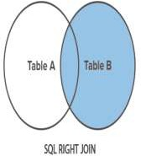

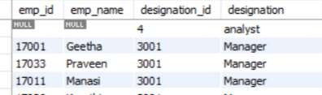
🞂​ The RIGHT JOIN keyword returns all records from the right table (table2), and the matching
records (if any) from the left table (table1).
QUERY :
select
emp_details.emp_id,emp_details.emp_name,designation_det.designation_id,designation_det. designationfrom emp_details right join designation_det on emp_details.designation_id=designation_det.designation_id order by designation_det.designation_id;
OUTPUT :

Slide 48
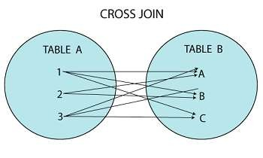

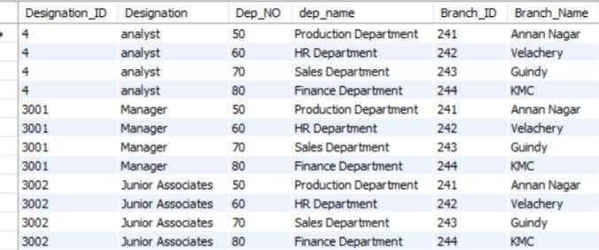
🞂​ The CROSS JOIN keyword returns all records from both tables (table1 and table2).
QUERY : select * from designation_det cross join department_det;

Slide 49

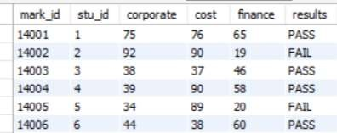
select *,
Case
when (marks_info1.cost>=35 and marks_info1.corporate>=35 and
marks_info1.finance>=35)
then "PASS“
else "FAIL"
end as results from marks_info1;

Slide 50
🞂​ Foreign key is used to maintain the relationship between two tables.
QUERY :
TABLE 1 : create table dep_info (dep_no int,dep_name varchar(30),branch_id int,
branch_name varchar(25),primary key(dep_no));
TABLE 2 : create table emp_info(emp_id int primary key,emp_name varchar(20),designation_id int,dep_no int,date_of_join date,constraint temp_foreign_key foreign key(dep_no)referencesdep_info(dep_no));
DROP FOREIGN KEY :
alter table Emp_info drop foreign key temp_Foreign_Key;

Slide 51
🞂​ A stored procedure is a prepared sql code that you can save,
🞂​ So the code can be reused over and over again.
🞂​ So if you have an SQL query that you write over and over again
🞂​ Save it as a stored procedure, and then just call it to execute it.
Advantages
🞂​ Decrease the Network traffic
🞂​ Centralize Business Logic For ex (If and or ElseIF)
🞂​ Fully secured
Disadvantages
🞂​ Resource usage
🞂​ Hard to maintain

Slide 52

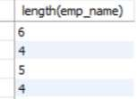





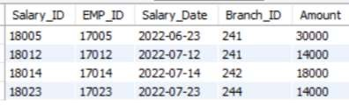
delimiter //
create procedure multi_query()
Begin
select * from emp_details;
select length(emp_name) from emp_details;
select * from salary_details where salary_id in(18005,18012,18032,18023,18014);
select count(emp_id) from emp_details;
end //
delimiter ;
call multi_query;

Slide 53


delimiter //
create procedure store_variables()
Begin
declare sum_amount int;
select sum(amount) into sum_amount from salary_details; select sum_amount;
end // delimiter ;
call store_variables;

Slide 54

🞂​ A database trigger is a stored program which is automatically fired or executed when some events occur.
Types of Trigger
Row Level Trigger
Statement Level Trigger
Row level Trigger -A event is triggered at row level for each row updated, inserted or deleted.
Statement Level trigger -An event is triggered at table Level for each sql statement executed.

Slide 55
🞂​ before insert
🞂​ after insert
🞂​ before update
🞂​ after update
🞂​ before delete
🞂​ after delete

Slide 56
create table student_info(student_id int,student_name varchar(25),citystate varchar(20),age int,community varchar(15),marks int,primary key(student_id));
delimiter //
create trigger age_modify before insert on student_info for each row Begin
if new.age<=0
then setnew.age=0;
end if ; end // delimiter ;
insert into student_info values
(1, 'Vasanth', 'Erode', 21, 'BC', 32),
(2,
(3,
'Guru', 'Tiruppur', 20, 'MBC', 78),
'Gokul', 'Tiruchirapalli', -18,null,89);
select * from student_info;

Slide 57

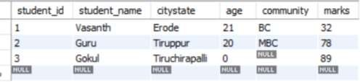
OUTPUT :

Slide 58

create table emp_pro(emp_id int,emp_name varchar(25),age int,daily_production int, primary key(emp_id));
create table emp_sal(emp_id int,sal int,primary key(emp_id)); delimiter //
create trigger prod_det after insert on emp_pro for each row Begin
if new.daily_production>=100 then
insert into emp_sal (emp_id,sal) values (new.emp_id,1000); elseif new.daily_production>=80 then
insert into emp_sal (emp_id,sal) values (new.emp_id,500); end if ;
end //
delimiter ;

Slide 59


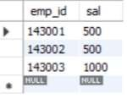
insert into emp_pro values
(143001, | 'Guru', | 21, | 85),
(143002, | 'Gopi', | 27, | 89),
(143003, | 'Mani', | 28, | 101);
select * from emp_pro;
select * from emp_sal;
OUTPUT:

Slide 60
THANK YOU

